Slide 1


Department of Electrical & Electronic Engineering
Green University of Bangladesh
Sequential Circuit
Prepared by
Rukhshana Parvin

Slide 2
Triggering of Flip-flop
State
Input
Output
Combinational Circuit
Memory
Latch/Flipflop
Clock Pulse
Control Input

Slide 3
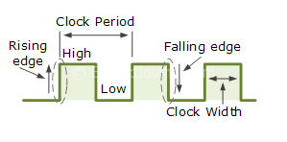
Triggering of Flip-flop
Edge Trigger
Level Trigger

Slide 4
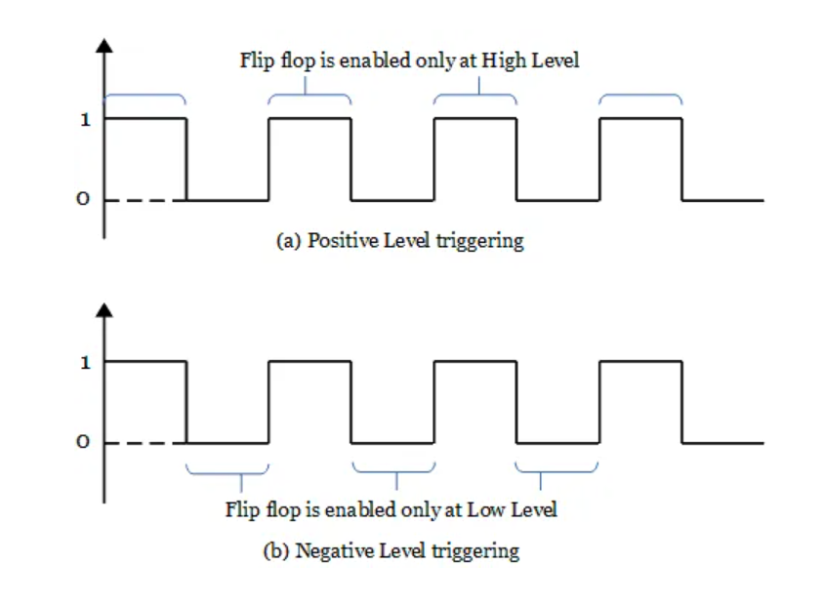
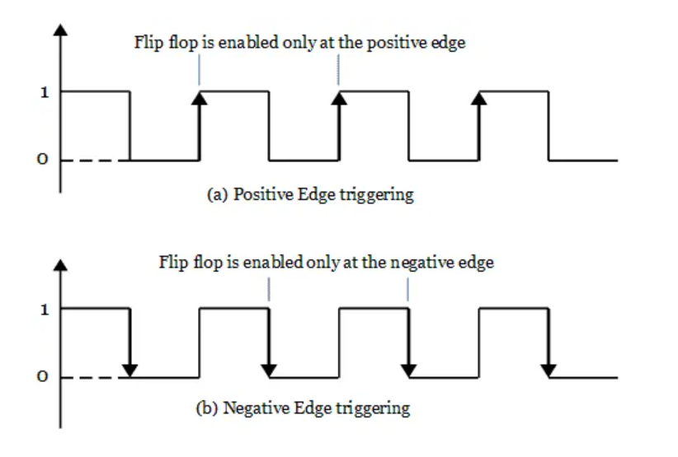
Triggering of Flip-flop
Level Trigger
Edge Trigger
The flip flop is triggered only during the high-level or the low level of the clock pulse.
Positive level triggering
Negative level triggering
In edge triggering, the flip flop changes its state during the positive edge or negative edge of the clock pulse.
Positive edge triggering
Negative edge triggering

Slide 5
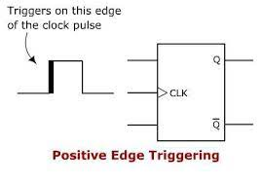
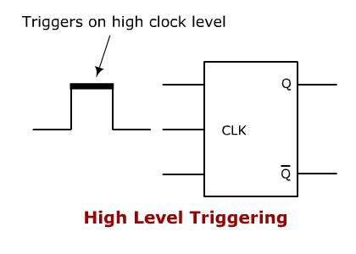
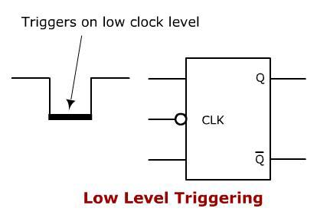
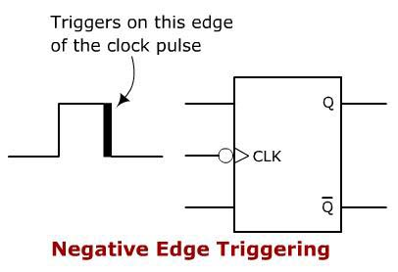
Triggering of Flip-flop

Slide 6
Clocked SR Flip-flop
SR Flip flop with Clock
Nand Latch

Slide 7
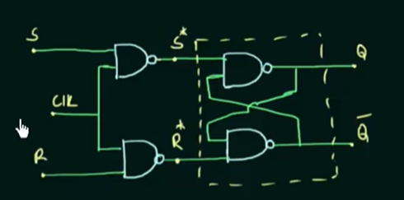
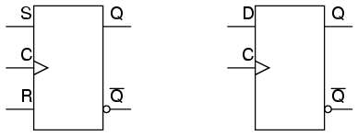

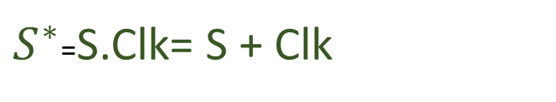
Clocked SR Flip-flop(cont’d)
$S^{∗}$=S.Clk= S + Clk
$R^{∗}$= R. Clk= R +Clk
This whole Circuit is SR Flip-Flop

Slide 8

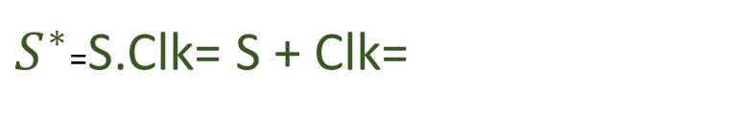
Clocked SR Flip-flop(cont’d)
S’+ 1= 1
$S^{∗}$=S.Clk= S + Clk=
$R^{∗}$= R. Clk= R +Clk
=R’+ 1=1
Clk | S | R | Q | Q’ | State
 |  |  | No Change | No Change | Memory
0
X
X
S* R*

Slide 9
Clocked SR Flip-flop(cont’d)
S’+0=S’
$S^{∗}$=S.Clk= S + Clk=
=1
$R^{∗}$= R. Clk= R +Clk
=R’+0=R’
=1
Clk | S | R | Q | Q’ | State
 |  |  | No Change | No Change | Memory
0
X
X
S* R*
1
0
0
Memory

Slide 10
Clocked SR Flip-flop(cont’d)
S’+0=S’
$S^{∗}$=S.Clk= S + Clk=
=1
$R^{∗}$= R. Clk= R +Clk
=R’+0=R’
=0
Clk | S | R | Q | Q’ | State
 |  |  | No Change | No Change | Memory
0
X
X
S* R*
1
0
0
Memory
1
0
1
0
1

Slide 11
Clocked SR Flip-flop(cont’d)
S’+0=S’
$S^{∗}$=S.Clk= S + Clk=
=0
$R^{∗}$= R. Clk= R +Clk
=R’+0=R’
=1
Clk | S | R | Q | Q’ | State
 |  |  | No Change | No Change | Memory
0
X
X
S* R*
1
0
0
Memory
1
0
1
0
1
1
1
0
1
0

Slide 12
Clocked SR Flip-flop(cont’d)
S’+0=S’
=0
$S^{∗}$=S.Clk= S + Clk=
$R^{∗}$= R. Clk= R +Clk
=R’+0=R’
=0
Clk | S | R | Q | Q’ | State
 |  |  | No Change | No Change | Memory
0
X
X
S* R*
1
0
0
Memory
1
0
1
0
1
1
1
0
1
0
1
1
1
1
1
invalid

Slide 13
Truth Table for Clocked SR Flipflop(cont’d)
Truth Table
Circuit
Clk | S | R | Q | Q’ | State
 |  |  | No Change | No Change | Memory
0
X
X
1
0
0
Memory
1
0
1
0
1
1
1
0
1
0
1
1
1
1
1
invalid

Slide 14
Truth Table for Clocked SR Flipflop(cont’d)
Characteristic Table
Truth Table
Qn | S | R | Qn+1
0 | 0 | 0 | 0
0 | 0 | 1 | 0
0 | 1 | 0 | 1
0 | 1 | 1 | X
1 | 0 | 0 | 1
1 | 0 | 1 | 0
1 | 1 | 0 | 1
1 | 1 | 1 | X
Clk | S | R | Qn+1
 |  |  | Qn
 |  |  | Qn
0
X
X
1
0
0
0
1
0
1
1
1
0
1
1
1
1
X

Slide 15
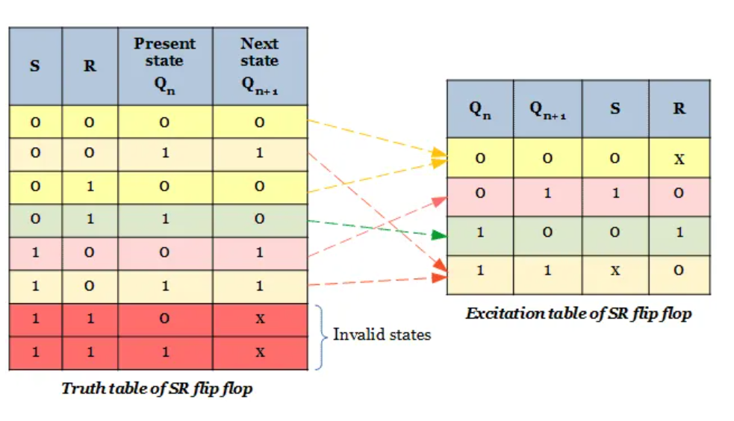
Truth Table for Clocked SR Flipflop(cont’d)
Characteristic Table
Excitation Table

Slide 16
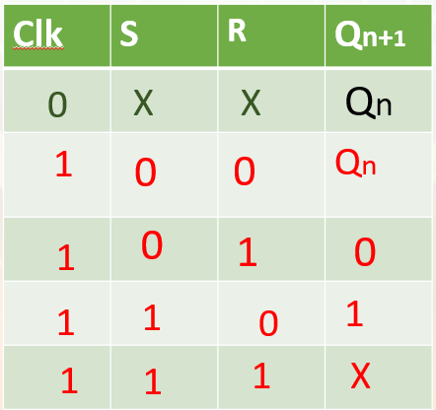
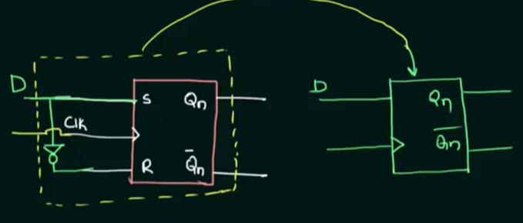
D flip-flop
Truth Table for SR flipflop

Slide 17
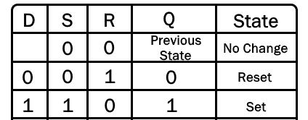
D flip-flop
Truth Table for D flip-flop
Truth Table for SR flipflop

Slide 18
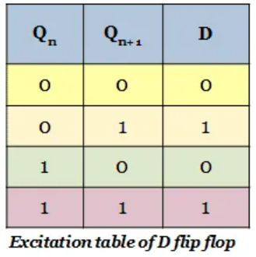
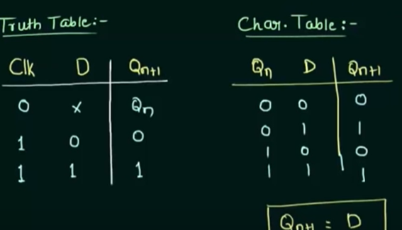
D flip-flop

Slide 19
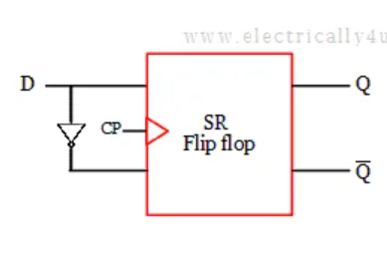
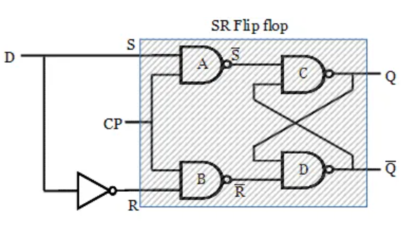
D flip-flop

